Slide 1
Derivatives Not in Terms of x

Slide 2
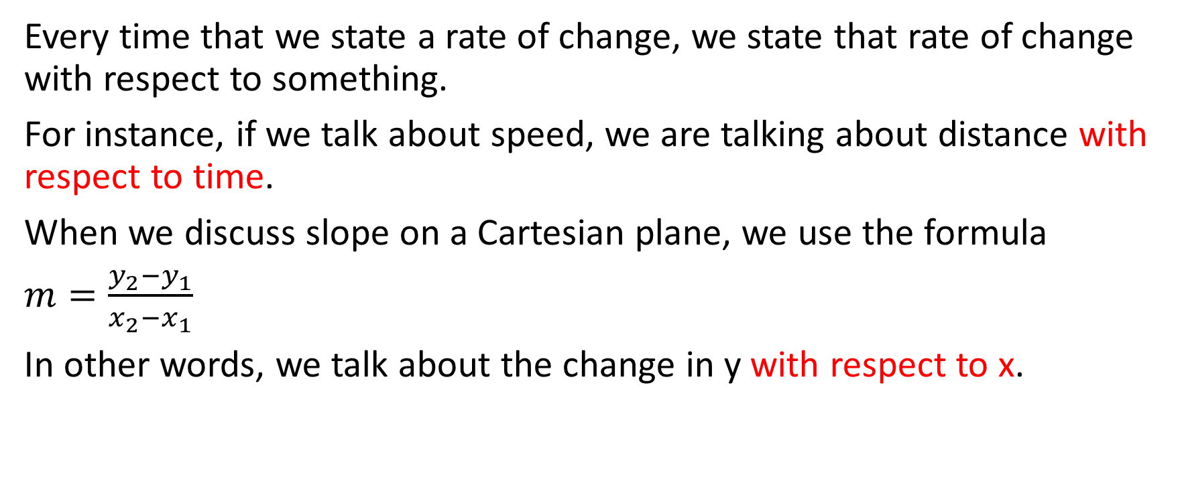
Every time that we state a rate of change, we state that rate of change with respect to something.
For instance, if we talk about speed, we are talking about distance with respect to time.
When we discuss slope on a Cartesian plane, we use the formula
$m=\frac{y_{2}−y_{1}}{x_{2}−x_{1}}$
In other words, we talk about the change in y with respect to x.

Slide 3
Similarly, when we determine a derivative (which is just an instantaneous rate of change, or slope at a point), we determine the derivative with respect to something. Usually, we determine a derivative with respect to x.
However, this isn’t always the case.

Slide 4

Example
Suppose $y=3{\left(2x^{2}+x−1\right)}^{4}$. Determine $\frac{dy}{dx}$

Slide 5
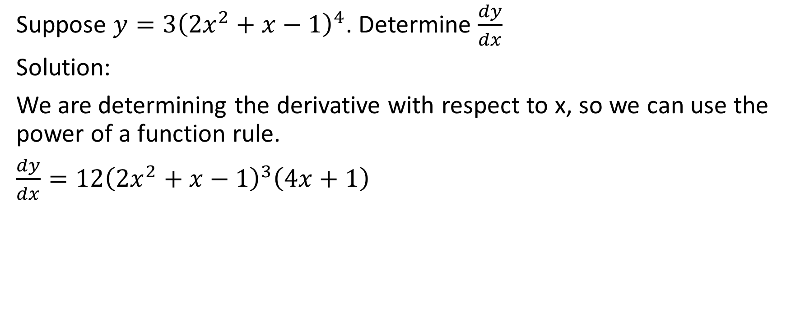
Suppose $y=3{\left(2x^{2}+x−1\right)}^{4}$. Determine $\frac{dy}{dx}$
Solution:
We are determining the derivative with respect to x, so we can use the power of a function rule.
$\frac{dy}{dx}=12{\left(2x^{2}+x−1\right)}^{3}\left(4x+1\right)$

Slide 6

Example
Suppose $y=3{\left(2x^{2}+x−1\right)}^{4}$. Determine $\frac{dy}{d\left(2x^{2}+x−1\right)}$

Slide 7
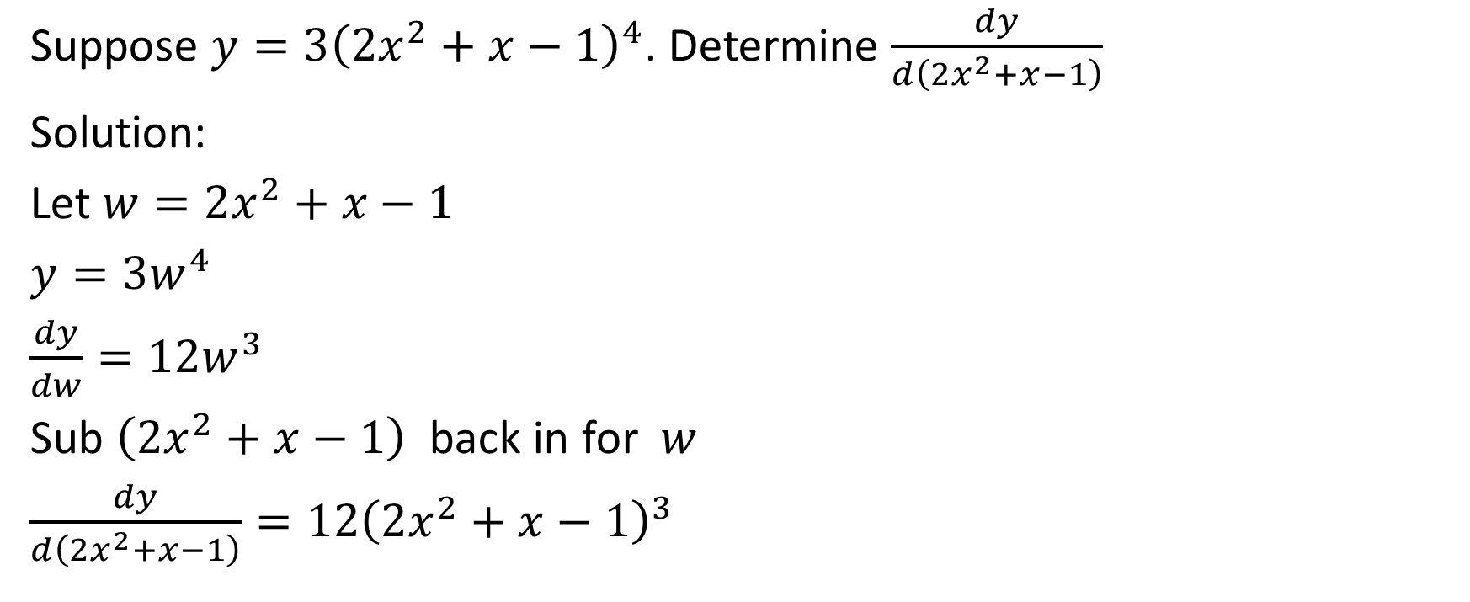
Suppose $y=3{\left(2x^{2}+x−1\right)}^{4}$. Determine $\frac{dy}{d\left(2x^{2}+x−1\right)}$
Solution:
Let $w=2x^{2}+x−1$
$y=3w^{4}$
$\frac{dy}{dw}=12w^{3}$
Sub $\left(2x^{2}+x−1\right)$ back in for $w$
$\frac{dy}{d\left(2x^{2}+x−1\right)}=12{\left(2x^{2}+x−1\right)}^{3}$

Slide 8
Suppose $y=3{\left(2x^{2}+x−1\right)}^{4}$. Determine $\frac{dy}{d\left(2x^{2}+x−1\right)}$
Solution:
Let $w=2x^{2}+x−1$
$y=3w^{4}$
$\frac{dy}{dw}=12w^{3}$
Sub $\left(2x^{2}+x−1\right)$ back in for $w$
$\frac{dy}{d\left(2x^{2}+x−1\right)}=12{\left(2x^{2}+x−1\right)}^{3}$
If you can do the question directly without substituting in a new variable, then that is perfectly acceptable.

Slide 9

Example
Determine $\frac{d\left[4\left(2x^{2}+8x+3\right)\right]}{dx}$

Slide 10

Determine $\frac{d\left[4\left(2x^{2}+8x+3\right)\right]}{dx}$
Solution:
$\frac{d\left[4\left(2x^{2}+8x+3\right)\right]}{dx}=4(4x+8)$

Slide 11
Determine $\frac{d\left[4\left(2x^{2}+8x+3\right)\right]}{dx}$
Solution:
$\frac{d\left[4\left(2x^{2}+8x+3\right)\right]}{dx}=4(4x+8)$
That’s it. That’s the answer. If you understand it like that, then you’re set and you don’t need to show any more work. However, sometimes people don’t quite get it on the first look, so let’s investigate a bit.

Slide 12

Determine $\frac{d\left[4\left(2x^{2}+8x+3\right)\right]}{dx}$
Solution:
Let $y=4\left(2x^{2}+8x+3\right)$
Now, we just need to determine $\frac{dy}{dx}$
$\frac{dy}{dx}=4\left(4x+8\right)$

Slide 13
Determine $\frac{d\left[4\left(2x^{2}+8x+3\right)\right]}{dx}$
Solution:
Let $y=4\left(2x^{2}+8x+3\right)$
Now, we just need to determine $\frac{dy}{dx}$
$\frac{dy}{dx}=4\left(4x+8\right)$
That’s it. That’s the answer. If you get it like that, then you don’t need to show any more work. However, sometimes people aren’t quite sure how we got this, so we’ll investigate a bit more deeply.

Slide 14
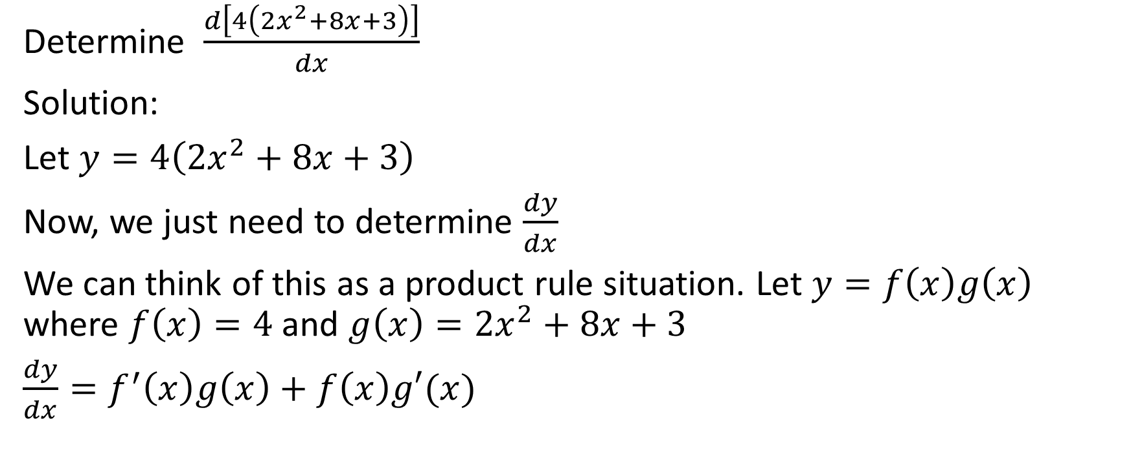
Determine $\frac{d\left[4\left(2x^{2}+8x+3\right)\right]}{dx}$
Solution:
Let $y=4\left(2x^{2}+8x+3\right)$
Now, we just need to determine $\frac{dy}{dx}$
We can think of this as a product rule situation. Let $y=f\left(x\right)g\left(x\right)$ where $f\left(x\right)=4$ and $g\left(x\right)=2x^{2}+8x+3$
$\frac{dy}{dx}=f^{′}\left(x\right)g\left(x\right)+f\left(x\right)g′(x)$

Slide 15

Determine $\frac{d\left[4\left(2x^{2}+8x+3\right)\right]}{dx}$
Solution:
Let $y=4\left(2x^{2}+8x+3\right)$
$\frac{dy}{dx}=f^{′}\left(x\right)g\left(x\right)+f\left(x\right)g′(x)$
$=\left(0\right)\left(2x^{2}+8x+3\right)+4(4x+8)$
$=4(4x+8)$

Slide 16

Example
Determine $\frac{d\left[{\left(3x^{2}−2x+2\right)}^{3}\right]}{d\left(3x^{2}−2x+2\right)}$

Slide 17

Determine $\frac{d\left[{\left(3x^{2}−2x+2\right)}^{3}\right]}{d\left(3x^{2}−2x+2\right)}$
Solution:
$\frac{d\left[{\left(3x^{2}−2x+2\right)}^{3}\right]}{d\left(3x^{2}−2x+2\right)}=3{\left(3x^{2}−2x+2\right)}^{2}$

Slide 18
Determine $\frac{d\left[{\left(3x^{2}−2x+2\right)}^{3}\right]}{d\left(3x^{2}−2x+2\right)}$
Solution:
$\frac{d\left[{\left(3x^{2}−2x+2\right)}^{3}\right]}{d\left(3x^{2}−2x+2\right)}=3{\left(3x^{2}−2x+2\right)}^{2}$
That’s it. That’s the solution. If you understand that, then no further work needs to be shown. However, if you’d like to show more steps, you can introduce a new variable like in the following steps.

Slide 19

Determine $\frac{d\left[{\left(3x^{2}−2x+2\right)}^{3}\right]}{d\left(3x^{2}−2x+2\right)}$
Solution:
Let $w=3x^{2}−2x+2$
$\frac{d\left(w^{3}\right)}{dw}=3w^{2}$
$=3{\left(3x^{2}−2x+2\right)}^{2}$

Slide 20

Example
Determine $\frac{d\left(2x^{2}+12x+18\right)}{d(x+3)}$

Slide 21

Determine $\frac{d\left(2x^{2}+12x+18\right)}{d(x+3)}$
Solution:
$2x^{2}+12x+18=2\left(x^{2}+6x+9\right)$
$=2{\left(x+3\right)}^{2}$
$\frac{d\left[2{\left(x+3\right)}^{2}\right]}{d(x+3)}=4(x+3)$

Slide 22
Determine $\frac{d\left(2x^{2}+12x+18\right)}{d(x+3)}$
Solution:
$2x^{2}+12x+18=2\left(x^{2}+6x+9\right)$
$=2{\left(x+3\right)}^{2}$
$\frac{d\left[2{\left(x+3\right)}^{2}\right]}{d(x+3)}=4(x+3)$
That’s the final answer. However, if that doesn’t make sense, then you can introduce a new variable and use substitution like this:

Slide 23

Determine $\frac{d\left(2x^{2}+12x+18\right)}{d(x+3)}$
Solution:
$2x^{2}+12x+18=2\left(x^{2}+6x+9\right)$
$=2{\left(x+3\right)}^{2}$
Let $w=x+3$
$\frac{d\left[2w^{2}\right]}{dw}=4w$
$=4(x+3)$

